Slide 1
TCP and UDP Protocol

Slide 2
TCP (Transmission Control Protocol)

Slide 3
TCP Overview
TCP is a protocol for data transmission
It operates on the transport layer of the TCP/IP suite
Is responsible for chopping up data in to ‘packets’
Wraps that packets with ‘TCP Header’
Is considered reliable
Requires a connection to be established using a ‘3 way handshake’
Designed for optimum delivery, not timely delivery
Can incur ‘long’ delays (could be several seconds)

Slide 4
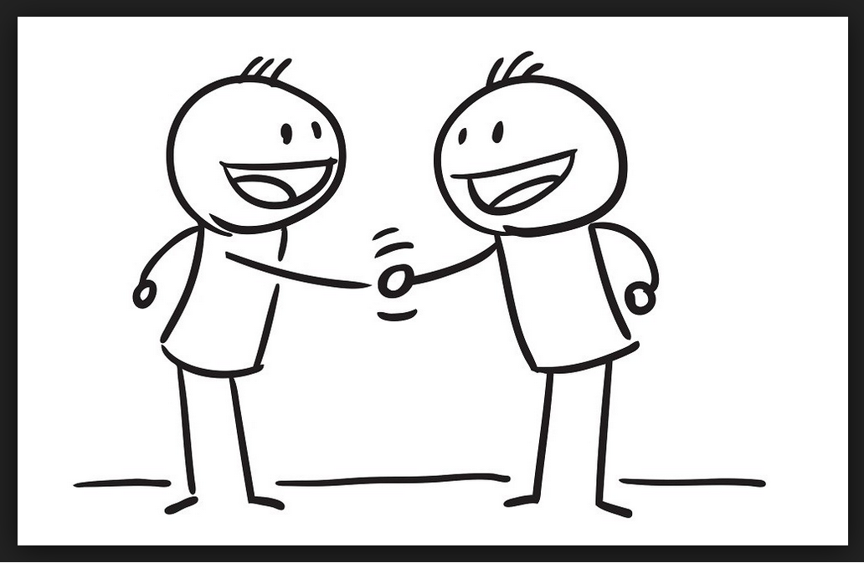
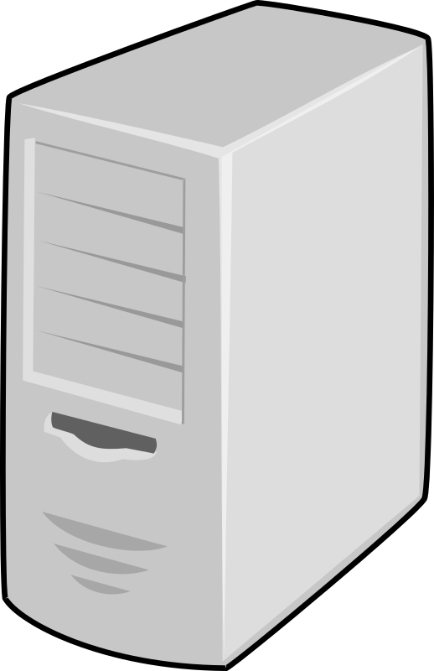
TCP 3 Way Handshake
ACK
SYN-ACK
SYN
Host A
Host B
Host A sends a TCP SYN packet to host B
Upon receiving the SYN packet, Host B responds with a SYN-ACK packet
Host A receives SYN-ACK and sends ACK
TCP Socket has been established.

Slide 5
Data Transfer
ACK
Host A
Host B
“This is a message”
“This is a message”
TCP Segmentation
TCP Reassembly
“This”
“is”
“a”
“message”
Notes:
To send message
Host A gets message,
Sends it to TCP where it is segmented in to packets (and wrapped with TCP header but im not showing that, to save space)
Packets are sent (they may arrive out of order and at different times
Host B TCP reassembles the packets in to the message
Host be sends ACK’s for each packet it receives.

Slide 6
TCP Data Transfer Cont
If a packet gets lost along the way.
Host A will increment a timer and when that timer reaches a set number, it will resend the packet, until it gets an ACK from host B

Slide 7
TCP Header
All data is segmented in to chunks and wrapped with a TCP header.
Source port
Destination port
Sequence Number
Acknowledgment Number
DO
RSV
Flags
Window
Checksum
Urgent pointer
Options
Notes:
Source port identifies the sender port
Dest port identifies the receivers port
Sequence Num the sequence number of this packet used for data reassembly and request resend of missing packets.
Data offset (DO) indicated where the actual data begins in the packet and thus the total size of the header.
Reserved (RSV) reserved for future use. Should be 0’s
Flags various flags, used for showing the state of the TCP connection including ACK, SYN and RST
Window number of octets in the TCP header
Checksum a cyclic redundancy check (CRC), calculated by the sender. Used by receive to verify payload. Payload rejected is not pass
Urgent pointer pointer to urgent data in packet. Only exists if the URG flag is set.
Options this section contains optional data that dose not need to be set in most cases.
Padding used to ensue that TCP header ends and data begins on a 32bit boundary.
Data the stuff we are sending. Some times referred to “payload”.

Slide 8
The TCP Joke
What's the best part about TCP jokes?
I get to keep telling them until you get them!

Slide 9
UPD (User Datagram Protocol)

Slide 10
UDP Overview
unreliable,
Fire and forget approach
Like TCP, it operates on the transport layer, above the network and physical layers but below the application layer
Dose not preform handshaking (connectionless)
Dose not preform error checking
Lower overhead and faster than TCP
Just like TCP, UDP splits up payload in to separate packets and attaches its own header
It is the Applications responsibility to detect and resolve errors
The IP layer handles the ordering, segmentation and reassembly of data.

Slide 11
UDP Header
Source Port
Destination Port
Length
Checksum
Data……
Notes:
Source port the port of the transmitting node
Destination port the port of the receiving node
Length the number of octets in the message. 16 bit values, allow for data up to 65,535 bytes.
Checksum checks data integrity. Optional in IP4, mandatory in IP6.

Slide 12
The UDP joke
Have you heard the UDP joke?
You might not get it and I don’t care if you do.

Slide 13
RUDP (Reliable User Datagram Protocol)

Slide 14
RUDP Overview
A response to the pros and cons of TCP and UDP
TCP prioritises reliably delivery
UDP prioritises speed
Both are needed to streaming content (like audio & video).
Provides reliable delivery up to MAX resubmissions (avoid stale signalling message)
Provides in-order delivery
Provides flow control
Low over head
Error detection

Slide 15
So it look like TCP
But uses UDP
How?!
Well it’s a combination of the 2
We define a protocol (header + data) that sits in traditional UDP
This protocol is where we hide all of the ordering information, message data, error checking, etc.

Slide 16
RUDP Header
SYN
ACK
EAK
RST
NUL
CHK
TCS
0
Header
Length
Sequence number
Ack Number
Checksum
Payload
Notes:
SYK synchronization segment is present
ACK identifies the acknowledgement number is valid
EAK identifies the extended acknowledgement segment is present
RST identifies this as a reset segment
NUL Identifies this as a null segment
CHK 1 or 0 to indicate that this check sum is valid on the header or the header and data
TCS identifies this a transfer connection state segment
0 always 0, could be padding.
https://www.ietf.org/proceedings/44/I-D/draft-ietf-sigtran-reliable-udp-00.txt

Slide 17
How do we use it?
I’m sure there are libraries available to help you do this but in essence….
You use a technique called Application-Layer Framing (more on this in a moment).
You take your data, get your application to chop it up and wrap it with the RUDP header.
Your application is now responsible for combining all of the packets in order
And error handling.
We send our custom RUDP packet over regular old UDP.

Slide 18
Application-Layer Framing
Application-Layer Framing/Application-Level Framing (ALF)
Gets the application (your code) to do the heavy lifting.
Simply uses other protocols for the data transmission.
The application layer splits up the data in to segments
These segments are processed (i.e. wrapped with the RUDP header, in our case)
Sent to the transport layer (UDP) and shipped off down the network
The application on the other end must also know how to read the ALF data in order to parse it.
This idea might be useful for you assignment

Slide 19
Questions?

